Slide 1
Employee Data Analysis using Excel
STUDENT NAME:M.Varsha
REGISTER NO:312210193(asunm22ca44)
DEPARTMENT:B.Com Computer applications
COLLEGE:Valliammal college for women

Slide 2
PROJECT TITLE
CREATING AN EMPLOYEE PERFORMANCE SCORECARD IN EXCEL.

Slide 3


AGENDA
Problem Statement
Project Overview
End Users
Our Solution and Proposition
Dataset Description
Modelling Approach
Results and Discussion
Conclusion
3/21/2024 Annual Review

Slide 4

PROBLEM STATEMENT
As a [Manager/HR Representative], I need a streamlined and data-driven approach to evaluate and track employee performance across various key performance indicators (KPIs). Currently, our performance evaluation process is manual, time-consuming,
- Accurately assess individual employee performance
- Identify areas for improvement and development
- Set clear goals and objectives
- Compare performance across teams and departments
- Make data-informed decisions for promotions, bonuses, and training initiatives

Slide 5
Automates data collection and calculation
- Standardizes performance metrics and evaluation criteria
- Provides real-time insights and visualizations
- Enables easy customization a nd scalability
- Enhances transparency and fairness in performance evaluations

Slide 6

PROJECT OVERVIEW
IT HAS,
Objective
Scope
Deliverable
Timeline
Success matrix

Slide 7

WHO ARE THE END USERS?
*Manager and supervisor
*HR representation
*Employees
*Department heads
*Senior leadership
*Talent development specialist.

Slide 8

OUR SOLUTION AND ITS VALUE PROPOSITION
Solution: Employee Performance Scorecard in Excel
Value Proposition:
"Streamline employee evaluations, boost productivity, and drive data-driven decisions with our customizable and automated Excel scorecard solution,

Slide 9
Dataset Description
1. Employee Information
2. Performance Metrics
3. Key Performance Indicators (KPIs)
4.Ratings and Scores
5. Goals and Objectives
6. Feedback and Comments
7. Development Plans

Slide 10

THE "WOW" IN OUR SOLUTION- *Automated Calculations: Effortlessly calculate performance scores, ratings, and racomprehens our pre-built formulas and conditional formatting.
- Customizable Dashboards
: Create personalized scorecards with intuitive drag-and-drop functionality, tailoring the layout to your organization's specific needs.
-
3/21/2024 Annual Review
10

Slide 11
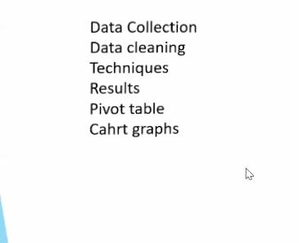
MODELLING
11

Slide 12
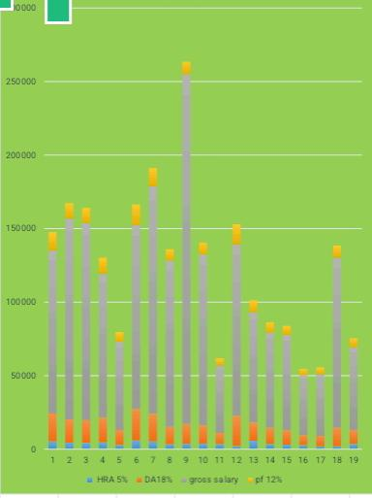
RESULTS
12

Slide 13
conclusion
Here, it is says that The salary benchmark is helps you to organize and summarizes your data so you can review situation that need to be employed

